Slide 1
Streamlit
The fastest way to create data apps

Slide 2
Streamlit
Open source
Free
Pure Python!
Simple and easy to use

Slide 3
Demo
Face-GAN explorer App that uses Shaobo Guan’s TL-GAN project from Insight Data Science, TensorFlow, and NVIDIA's PG-GAN to generate faces that match selected attributes.
Real-time object detection An image browser for the Udacity self-driving-car dataset with real-time object detection.

Slide 4
Three principles
Embrace Python scripting Build an app in a few lines of code in a simple Python file. Then see it automatically update as you save the source file.
Weave in interaction Adding a widget is as simple as declaring a variable. No need to write a backend, define routes, handle HTTP requests, etc.
Reuse data & computation Caches computation to allow the user to rerun scripts without it being insanely slow.

Slide 5
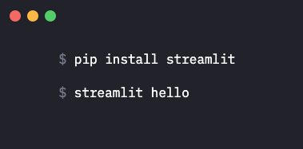
Get started instantly

Slide 6
Deploy
Locally http://localhost:8501
Community Edition beta Free one-click deployment for open-source Streamlit apps.
Streamlit for Teams Still in development, Streamlit for Teams provides one-click deployment with enterprise-grade features like authentication, logging, and auto-scaling.

Slide 7
Live demo tutorial

